Slide 1
cf=j= @)&(–*) sf] kflnsf :t/Lo kf]if0f sfo{qmd ;dLIff tyf of]hgf th'{df uf]i7L
:jf:Yo ;+:yfsf] gfdM
ldltM
:yfgM

Slide 2
cg'dflgt hg;+Vof cf=j= @)&*÷&(
qm=;+= | zLif{s | s"n cg'dflgt hg;+Vof
! | cg'dflgt hLljt hGd
@ | cg'dflgt ue{jtL
# | @ b]lv %( dlxgfsf lzz' tyf afnaflnsf
$ | ) b]lv @# dlxgfsf afnaflnsf
% | ^ b]lv @# dlxgfsf afnaflnsf
^ | ^ b]lv %( dlxgfsf afnaflnsf
& | !) b]lv !( jif{sf lszf]/L
* | k|hgg pd]/sf dlxnf -!% b]lv $( jif{_

Slide 3
dfgj ;+;fwg
qm=;+= | kb | :jLs[t b/aGbL ;+Vof | kbk"lt{ | SBA tflnd k|fKt | CNSI tflnd -;+Vofdf_ |  | CB-IMNCI tflnd -;+Vofdf_ |  | Remarks
 |  |  |  |  | lnPsf] | glnPsf] | lnPsf] | glnPsf]
! | d]= c=
@ | x]=c= jf l;=c=x]=j=
# | :6fkm g;{
$ | c=g=dL=
% | c=x]=a=
^ | Nof=c=÷Nof=6]
& | cGo
hDdf

Slide 4
pks/0fsf] ljj/0f
qm=;+= | pks/0fx?sf] gfd | pknAw |  | s}lkmot
 |  | 5 | 5}g\
! | tf}n lng] d]lzg -Analogue, digital, 2 in 1_
@ | ;fN6/ :s]n -with trouser and stand_
# | Pan Scale
$ | Height Board -prfO{ af]8{_
% | l8lh8n ydf]{ld6/
^ | MUAC Tape -aRrf_
& | MUAC Tape -jo:s_
* | ARI Timer
( | Penguin/De Lee Suction -aly{+u ;]G6/ eP dfq_
!) | Jofu P08 df:s
!! | Tanka (ltgsf] afs;) kf]if0fhGo ;fdfu|L /fVg
!@ | cGo -yk ug'{xf];\_===================================

Slide 5
cf}ifwLx?sf] ljj/0f
qm=;+= | gfd | df}hbft |  | s}lkmot
 |  | 5 | 5}g\
! | afnle6f
@ | le6fldg P
# | h'sfsf] cf}ifwL
$ | cfO{/g rSsL
% | lh+s rSsL
^ | k'g{hlno emf]n -ORS_
& | Cotrim
* | RUTF -OTC jf jlx/+u pkrf/ s]Gb| ePdf_
( | h'sfsf] cf}ifwL
!) | Amoxicillin
!! | Gentamycin
!@ | gfeL dnd
!# | s08d
!$ | l8kf]
!% | lkN;
!^ | IUCD
!& | Implant

Slide 6
clen]v tyf k|ltj]bg kmf/dx?
qm=;+= | ljj/0f | df}hbft |  | s}lkmot
 |  | 5 | 5}g\
! | IMAM /lhi6/ -OTC jf jlx/+u pkrf/ s]Gb| ePdf_
@ | CB-IMNCI /lhi6/
# | IMAM sf8{ -OTC jf jlx/+u pkrf/ s]Gb| ePdf_ HMIS 2.5
$ | afn :jf:Yo sf8{
% | kf]if0f ;]jf /lhi6/
^ | ufFp3/ lSnlgs /lhi6/
& | kl/jf/ lgof]hg ;]jf /lhi6/
* | dfl;s cg'udg l;6 -Monthly Monitoring Sheet_
( | Tally Sheet (HMIS 1.6)
!) | l8kmN6/ jf clgoldttf vf]h k"hf{ -HMIS 1.5_
!! | k|]if0f jf :yfgfGt/0f k"hf{ -HMIS 1.4_

Slide 7
qm=;+= | IEC/BCC ;fdfu|L | df}hbft |  | s}lkmot
 |  | 5 | 5}g\
! | MIYCN lˆnk rf6{
@ | MIYCN Wheel Card (;'cfxf/faf6)
# | lh+s k/fdz{ sf8{
$ | IMAM gb]{lzsf @)&$
% | MIYCN gb]{lzsf @)&$
^ | HMIS gb]{lzsf -@)&) jf ;f] eGbf dfly_
& | HMIS Indicators Book -@)&) jf ;f] eGbf dfly_
* | IMNCI pkrf/ k'l:tsf
( | :tgkfg ;DalGw flex
!) | k"/s tyf yk vfgf ;DalGw l;kmfl/; ul/Psf Jojxf/x? -AFATVAH flex_
!! | :tgkfg j[If
!@ | kl/jf/ lgof]hgsf] ;fwg ;DalGw ;';'lrt 5gf}6sf nflu ;]tf] flex -;'cfxf/fåf/f k|bfg ul/Psf]_
!# | afnle6f ;DalGw flex
!$ | j[l4 cg'udg tyf kfv'/f gfk ;DalGw flex
!% | x/]s af/ vfgf rf/ ;DalGw flex
!^ | WASH ;DalGw flex tyf kf]:6/
Notes:
त्रमशः सबै सामग्रीको विवरण दिन जरुरी छैन् । अभाव भएको वा मौज्दात कम भएको सामग्रीलाई मात्र जोड्नुहोस् ।

Slide 8
INDICATORS | Unit | FY 2076/77 | FY 2077/78 | FY 2078/79 | Remarks
REPORTING STATUS
% of PHC-ORC clinics Conducted | %
% of Immunization clinics Conducted | %
% of Female Community Health Volunteers (FCHVs) reporting to Health Facility | %
Average number of People served by PHC-ORC (Per clinic) | No.
Average number of People served by Immunization Clinic (Per clinic) | No.
Average number of People served by FCHV per month (Per month per FCHV) | No.
% of mothers group meeting held | %

Slide 9
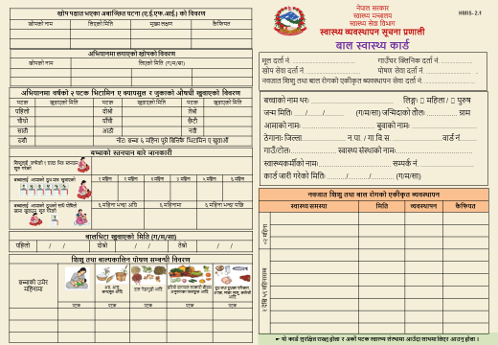
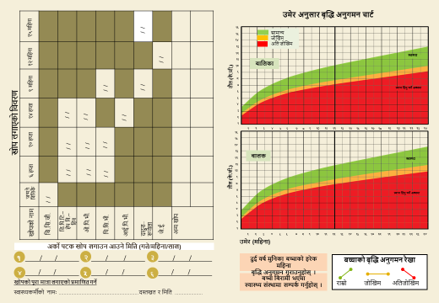
a[l4 cg'udg tyf k|j{4g sfo{qmd
GROWTH MONITORING AND PROMOTION PROGRAM INDICATORS | Unit | FY 2076/77 | FY 2077/78 | FY 2078/79 | Remarks
Percentage of children aged 0-23 months registered for growth monitoring | %
Average number of visits among children aged 0-23 months registered for growth monitoring | No.
% of children aged 0-23 months registered for Growth Monitoring (New) who were Underweight | %

Slide 10
lzz' tyf afNosflng kf]if0f -IYCF_
INFANT AND YOUNG CHILD FEEDING (IYCF) PROGRAM | Unit | FY 2076/77 | FY 2077/78 | FY 2078/79 | Remarks
Percentage of children aged 0- 6 months registered for growth monitoring who were exclusively breastfed for the first six months | %
% of children aged 6–8 months registered for growth monitoring who received solid, semi-solid or soft foods | %

Slide 11
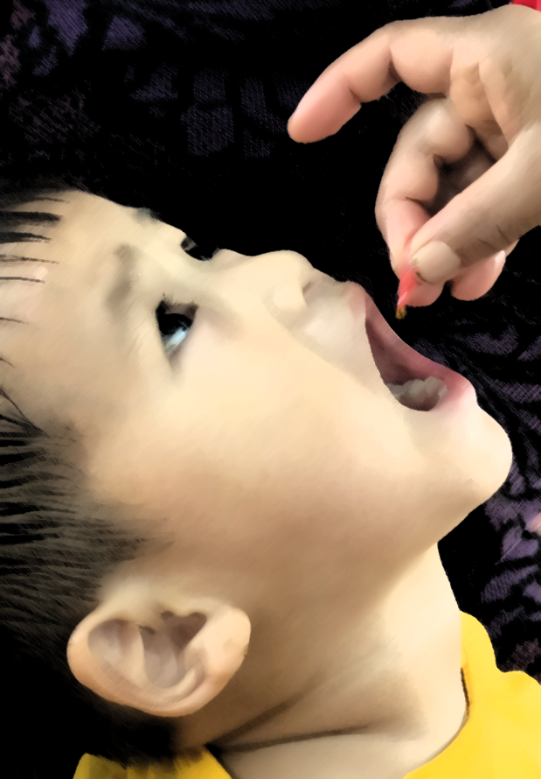
;'Id kf]ifs tTj ljt/0f tyf k/hLjL lgoGq0f sfo{qmd

Slide 12
MICRO-NUTRIENT SUPPLEMENTATION PROGRAM | Unit | FY 2076/77 | FY 2077/78 | FY 2078/79 | Remarks
Vitamin A mass distribution coverage 1st Round | %
Vitamin A mass distribution coverage 2nd Round | %
Deworming tablet mass distribution coverage 1st Round | %
Deworming tablet mass distribution coverage 2nd Round | %
% of children aged 6-23 months who received at least one cycle (60 Sachets) Baal Vita (MNP) | %
% of children aged 6-23 months who received 3 cycle (180 Sachets) Baal Vita (MNP) | %

Slide 13
zL3| s'kf]if0fsf] Plss[t Joj:yfkg sfo{qmd
INTEGRATED MANAGEMENT OF ACUTE MALNUTRITION (IMAM) PROGRAM | Unit | FY 2076/77 | FY 2077/78 | FY 2078/79 | Remarks
# of 6-59 months children with Severe Acute Malnutrition (SAM) admitted at OTCs | %
# of 6-59 months children with Severe Acute Malnutrition (SAM) discharged at OTCs | %
% of 6-59 months children with SAM admitted at OTCs who recovered | %
% of 6-59 months children with SAM at OTCs who defaulted | %
% of 6-59 months children with SAM admitted at OTCs who died | %

Slide 14
dft[ tyf gjhft lzz' ;'/Iff sfo{qmd

Slide 15
SAFE MOTHERHOOD AND FP PROGRAM INDICATORS | Unit | FY 2075/76 | FY 2076/77 | FY 2077/78 | Remarks
Percentage of pregnant women who had at least one ANC checkup | %
Percentage of pregnant women who had First ANC checkup as protocol | %
Percentage of pregnant women who had four ANC checkups as per protocol (4th, 6th, 8th and 9th month) | %
Percentage of women who had four ANC check-ups as per protocol (4th, 6th, 8th and 9th months) and delivered in a health facility) | %
Percentage of women who received a 180-day supply of Iron Folic Acid during pregnancy | %
Percentage of women who had 3 PNC check-ups as per protocol (1st within 24 hours, 2nd within 72 hours and 3rd within 7 days of delivery) | %
Percentage of postpartum women who received a 45-day supply of IFA | %
Percentage of postpartum women who received Vitamin A supplementation | %
Contraceptive Prevalence Rate (CPR) [Modern Method] | %

Slide 16
ljBfno :jf:Yo tyf kf]if0f sfo{qmd
INDICATORS | FY 2076/77 | FY 2077/78 | FY 2078/79
% of students in grade 1-10 who received anti-helminthic
% of adolescent's girls aged 10-19 years who received iron supplementation for 26 weeks

Slide 17
:jf:Yo ;+;yf :t/df kf]if0f ;+u ;DalGwt ;+rflnt sfo{s|dx?
kf]if0f ;+u ;DalGwt lhNnf tyf kflnsfdf ;+rflnt sfo{s|dx?sf] gfd | lg/Gt/ ;+rfng eO{/x]sf] 5 jf 5}g | 5}g eg] sf/0f tyf ;d:ofx? | ;dfwfgsf pkfPx?
afn le6f (MNP) k|j4{g sfo{qmd
zL3| s'kf]if0fsf] Plss[t Joj:yfkg sfo{s|d
cfO{/g kmf]lns Pl;8 sfo{s|d
dft[, lzz' tyf afNosfnLg kf]if0f sfo{qmd

Slide 18
:jf:Yo ;+:yf :t/df kf]if0f ;Fu ;DalGwt ;+rflnt sfo{s|dx?
kf]if0f ;+u ;DalGwt lhNnf tyf kflnsfdf ;+rflnt sfo{s|dx?sf] gfd | lg/Gt/ ;+rfng eO{/x]sf] 5 jf 5}g | 5}g eg] sf/0f tyf ;d:ofx? | ;dfwfgsf pkfPx?
;"Id kf]ifs tTjx?sf] sdLsf] lgoGq0f / /f]syfd
cfof]l8gsf] sdLn] x'g] ljs[tLsf] /f]syfd / lgoGq0f
j[l4 cg'udg tyf k|j{4g sfo{qmd
ljBfno :jf:Yo tyf kf]if0f sfo{qmd

Slide 19
kf]if0f sfo{s|dsf ;r'sx?df b]lvPsf k|utLx? tyf gjLGtd k|of;x?
!=============================================================================
@==============================================================================
#=================================================================================
$================================================================================
%================================================================================

Slide 20
kf]if0f sfo{s|d ;+u ;DalGwt ;d:ofx?
!=============================================================================
@==============================================================================
#=================================================================================
$================================================================================
%================================================================================

Slide 21
kf]if0f sfo{s|d k|efjsf/L ;+rfngsf nfuL ;dfwfgsf pkfPx?
!=============================================================================
@==============================================================================
#=================================================================================
$================================================================================
%================================================================================

Slide 22
Kfflnsf :t/df :jf:Yo tyf kf]if0f sfo{qmddf ;xof]uL ;+:yfx?

Slide 23
kf]if0f sfo{qmd ;DalGw tl:a/x?

Slide 24
s'g} lh1fzf<

Slide 25
wGojfb

